Slide 1













J.B.INSTITUTE OF ENGINEERING AND TECHNOLOGY
(UGC AUTONOMOUS)
Accredited by NAAC & NBA, Approved by AICTE & Permanently Affiliated to JNTUH
Organized by

Slide 2


TEAM DETAILS
1
Selected Track - MALCIOUS DELECTION
2
Problem Statement Title – SMART MALICIOUS ACTIVITY DETECTOR
3
Team Name - DATA DEFENDERS
4
Team Lead - MANDULA PRANEETH
5
Dept. Name - CSE(Artificial Intelligence & Machine Learning)

Slide 3
Smart malicious activity detector
Proposed our Prototype
Our idea is to create a Malicious Detector that can find and stop harmful activities like viruses, phishing links, or suspicious files. It uses AI and Machine Learning to study system or network behavior and quickly alert the user when something looks dangerous.
How it addresses the problem
It automatically detects and blocks harmful actions before they cause any damage.
helps people and organization stay safe from cyberattacks.

Slide 4
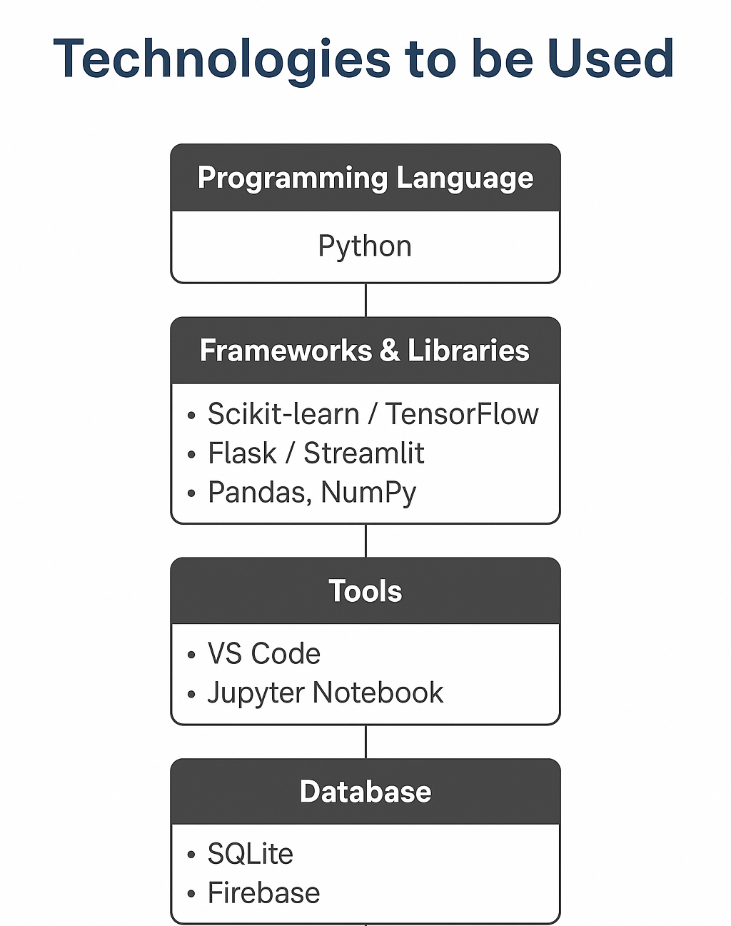
TECHNICAL APPROACH

Slide 5
FEASIBILITY AND VIABILITY
🧩 Feasibility Analysis
The idea is technically feasible using available AI and ML libraries like Scikit-learn or TensorFlow.
It can be built using open-source datasets for training (malicious vs. safe data).
The project can run on basic hardware (laptop or cloud server).
⚠️ Potential Challenges & Risks
Getting a large and accurate dataset for training.
False positives — sometimes safe files or URLs might be marked as malicious.
Maintaining real-time performance with large data.
Protecting user privacy during data analysis.
💡 Strategies to Overcome Challenges
Use trusted open datasets and perform regular updates to improve accuracy.
Apply data preprocessing and fine-tuning to reduce false results.
Optimize code to make the system lightweight and fast.
Implement strong encryption to secure user data and logs.
Potential challenges and risks
Strategies for overcoming these challenges

Slide 6
IMPACT AND BENEFITS
Potential impact
Our solution will help people understand and handle problems easily. It will make their work faster, safer, and more comfortable. The main goal is to improve daily life by using simple and smart technology.
Benefits of the Solution
Social: Helps people stay connected and solve problems together.
Economic: Saves money and time by reducing waste and improving efficient.
Environmental: Reduces pollution and supports eco-friendly living.

Slide 7
Team Member’s Information
Team Leader Name: (MANDULA PRANEETH)
Year: 3RD Department: CSM Roll Number:2367A66
Team Member 1 Name: ( KUDHANAM TEJA SRI)
Year: 3RD Department: CSM Roll Number: 24675A6603
Team Member 2 Name: (POLEMONI GEETHA SREE)
Year: 3RD Department: CSM Roll Number:24675A6601
Team Member 3 Name: (KATARI MOUNIKA)
Year: 3RD Department: CSM Roll Number:24675A6606

Slide 8


